Slide 1

CSC364-Software Engineering Week-1 Lecture-6 Semester-# Fall 2018
Prepared by:
M. Sajid Farooq

Slide 2
An Example
In this example an embedded system is to be developed for a booth. This system will be sold to the retail stores and will be used by the store customers.

Slide 3
Business Requirements Developers View
Leasing or selling this booth to the retailer.
Selling consumable through this booth to the customer.
Attracting customers to the brand.
Modifying the nature of the historical developer-customer relationship.

Slide 4
Business Requirements Retailer’s View
Making money from customer use of this booth.
Attracting more customers to the store.
Saving money if the booth replaces manual operations.

Slide 5
Conflicting Objectives
The developer might want to establish a high-tech and exciting new direction for the customer, while the retailer wants a simple, turnkey system, and the customer wants convenience and features.

Slide 6
Vision Statement An Example
The Chemical Tracking System will allow scientists to request containers of chemicals to be supplied by the chemical stockroom or by vendors. The location of every chemical container within the company, the quantity of material remaining in it, and the complete history of each container’s location and usage will be known by the system at all times. The company will save 25% on chemical cost by

Slide 7
Vision Statement An Example - continued
fully exploiting chemicals already available within the company, by disposing of fewer partially used or expired containers, and by using a standard chemical purchasing process. The Chemical Tracking System will also generate all reports required to comply with federal and state government regulations that require the reporting of chemical usage, storage and disposal.

Slide 8
Use Case Model
Use Case
Actor

Slide 9
Use Case Model
Use Case
Boundaries of the system are defined by functionality that is handled by the system.
Each use case specifies a complete functionality (from its initiation by an actor until it has performed the requested functionality).
Actor
An entity that has an interest in interacting with the system – a human or some other device or system.

Slide 10
Use Case Model
A use must always deliver some value to the actor.

Slide 11
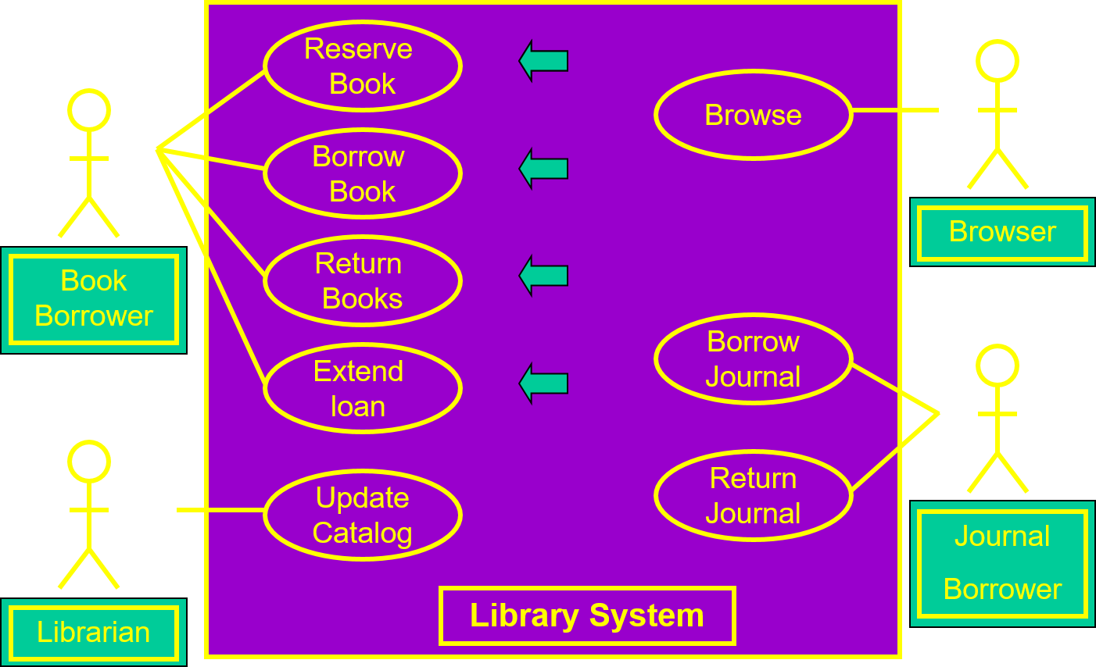
Use Diagram for a Library System

Slide 12
Recap

Slide 13
Business Requirement

Slide 14
Vision Statement

Slide 15
Context Diagram

Slide 16
Involvement of the Development team

Slide 17
Building a Relationship

Slide 18
Use Cases Ivar Jacobson 1994

Slide 19
Use Case Model

Slide 20
Creating the Use Case Model

Slide 21
Summary of Today’s Discussion

Slide 22
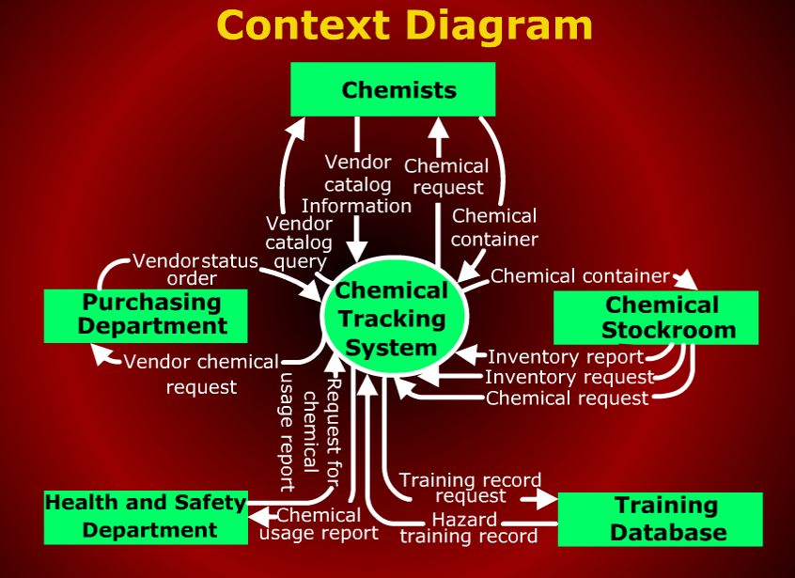
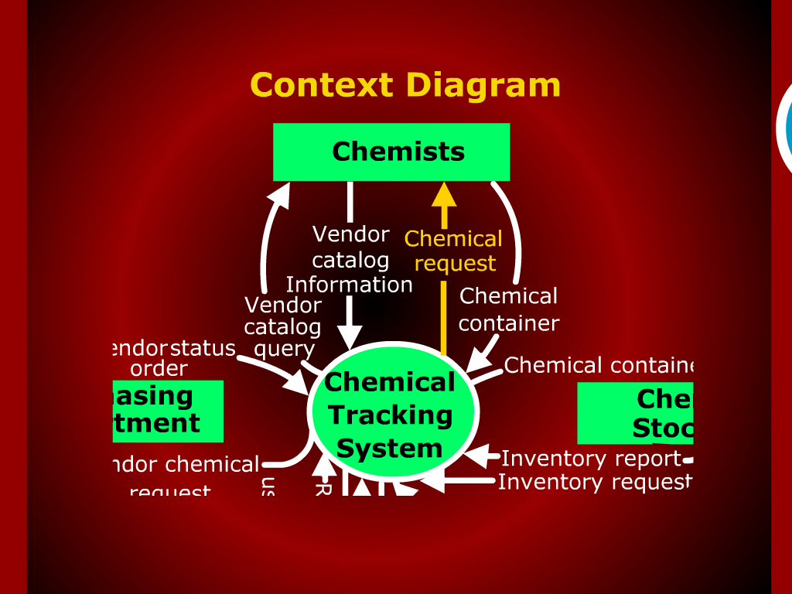

Slide 23
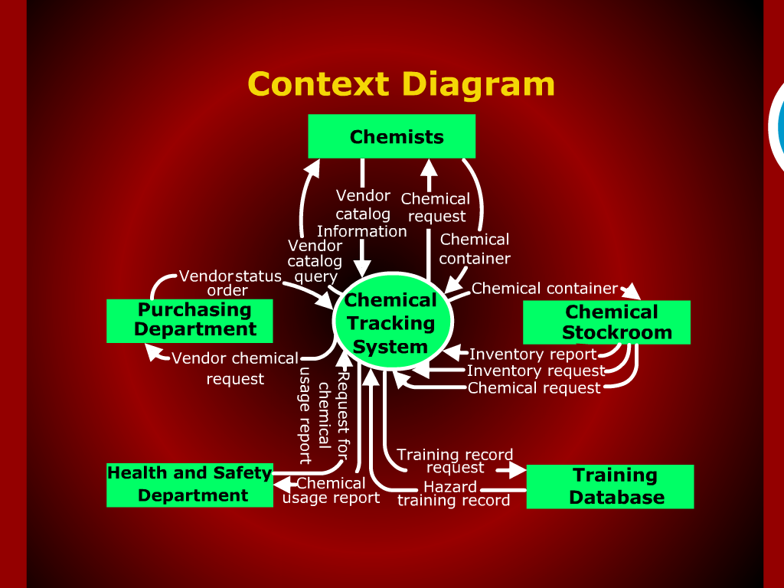

Slide 24
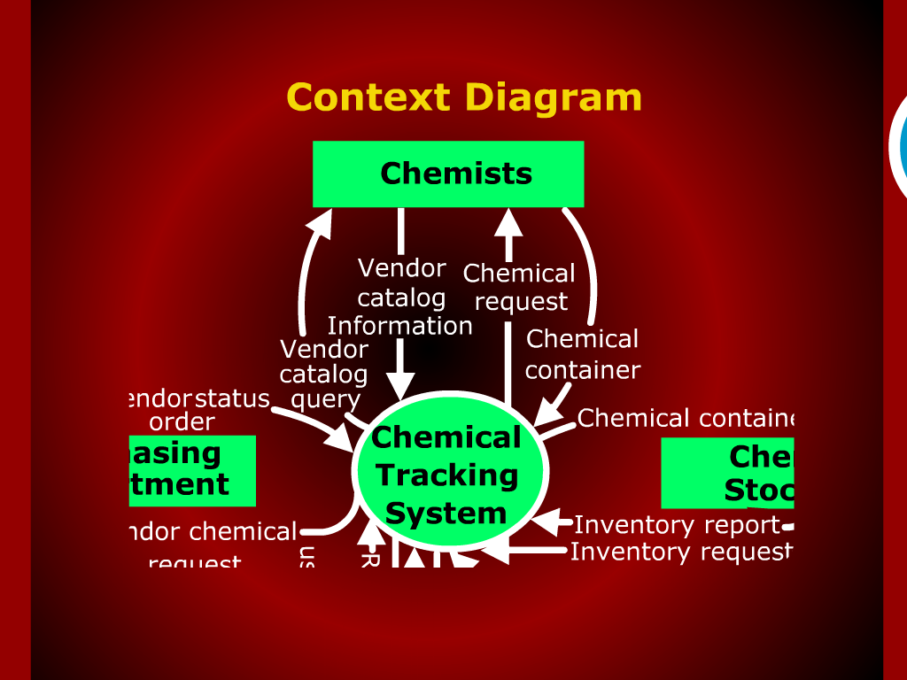

Slide 25
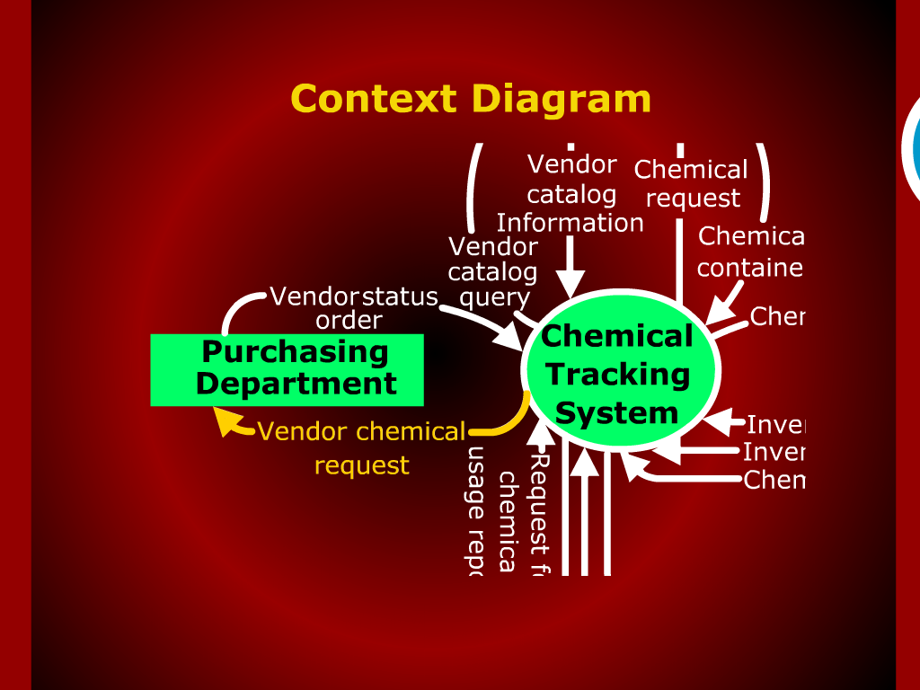

Slide 26
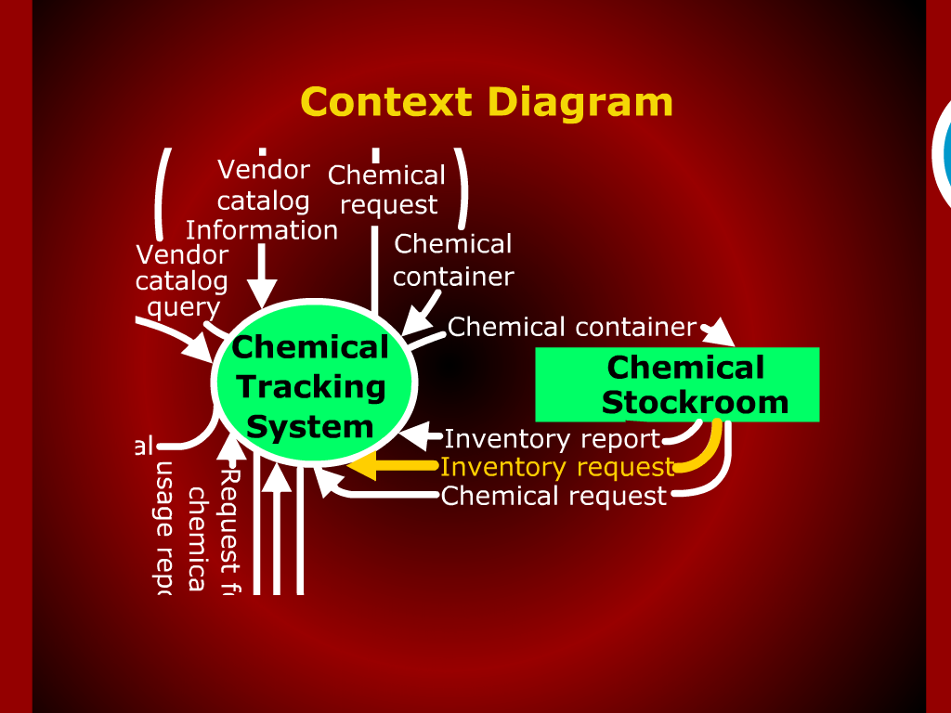

Slide 28
The End

Slide 29
Q & A

Slide 30
References
These lecture notes were taken from following source:

